Slide 1


SQL MURDER MYSTERY: Who Killed the CEO? An Investigation in Data Analytics and Logical Queries
ARINDAM DAS │Lead Data Detective

Slide 2
TABLE OF CONTENTS
01
02
03
04
INITIAL INVESTIGATION
INTRODUCTION
EVIDENCE
CONCLUSION

Slide 3

FOLLOWING THE DIGITAL FOOTPRINT
Unmasking the Killer, Query by Query.

Slide 4
01
INTRODUCTION
Every single lie, every swipe, and every call has been recorded. The database confesses

Slide 5
PRINCIPAL SIGNS OF MURDER
The crime follows the Premeditated Digital Betrayal Pattern.
This pattern is defined by the suspect's strategic use of the corporate system to execute and then cover up the murder, with the entire sequence recorded in the databases:
Exclusive Access: The killer exploited their system credentials to secure a private, precise window in the CEO's Office.
Recorded Deception: The suspect's own actions (filing a false alibi) were immediately contradicted by the system's objective access logs.
Corroborated Intent: Communication (a phone call) occurred during the execution phase, and physical evidence (fingerprints, log mismatch) confirmed the deliberate effort to tamper with the scene.

Slide 6

WHOA! LET’S DIVE INTO THE CASE.
"The question isn't 'who'—it's 'which query?'"
I am Arindam Das; professional detective and I took this case.

Slide 7
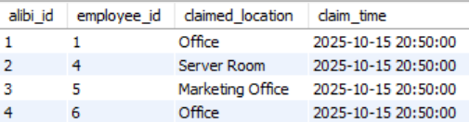
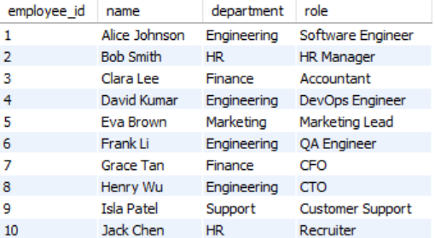
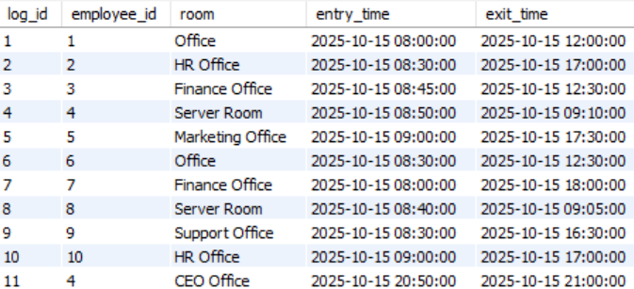
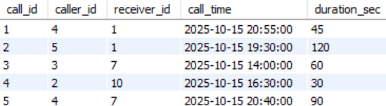
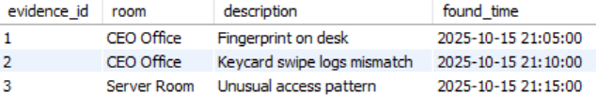
The Database: Digital Clue Board
Keycard_logs
Alibi
employees
Calls
evidence

Slide 8
02
INITIAL INVESTIGATION

Slide 9
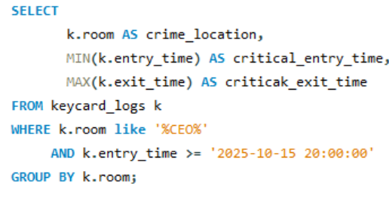
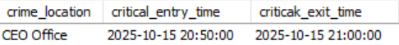
Identify the Crime Location & Time
🎯 Goal
Find where the crime happened and the approximate time
🧩 Clue Expected
Earliest evidence in the CEO Office = crime location + time window.

Slide 10
“The little things are infinitely the most important.
— Sherlock Holmes.

Slide 11
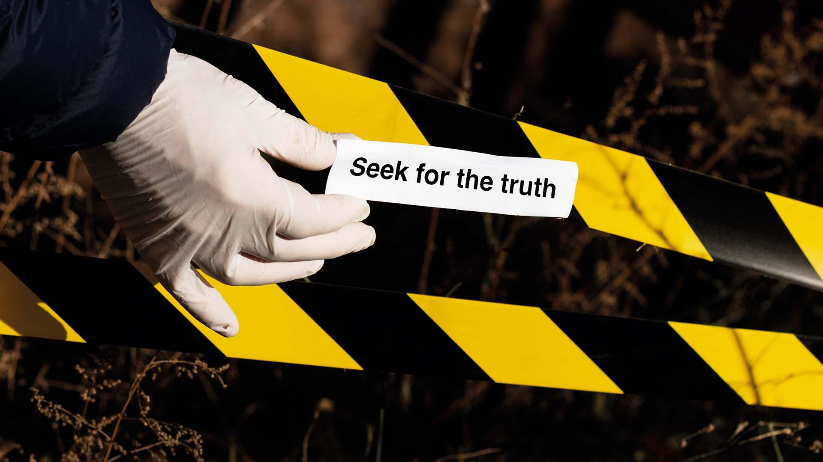
A PICTURE IS WORTH A THOUSAND WORDS

Slide 12
03
EVIDENCE

Slide 13
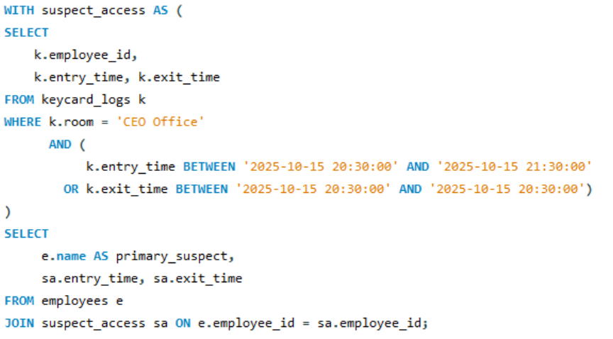
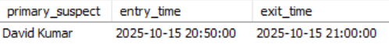
Analyze who accessed critical areas at the time
🎯 Goal
Get all employees who entered/exited the CEO Office around the crime window.
🧩 Clue Expected
Anyone entering 20:40–21:20 becomes a suspect.

Slide 14
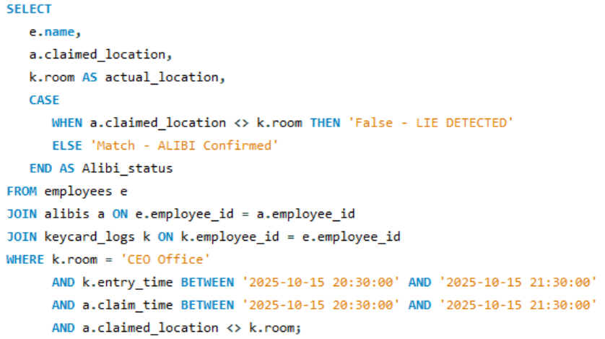
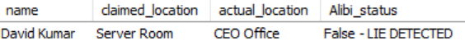
Cross-check Alibis with logs
🎯 Goal
Check which alibis don’t match keycard logs.
🧩 Clue Expected
If someone claims they were somewhere but no keycard confirms it → false alibi.

Slide 15
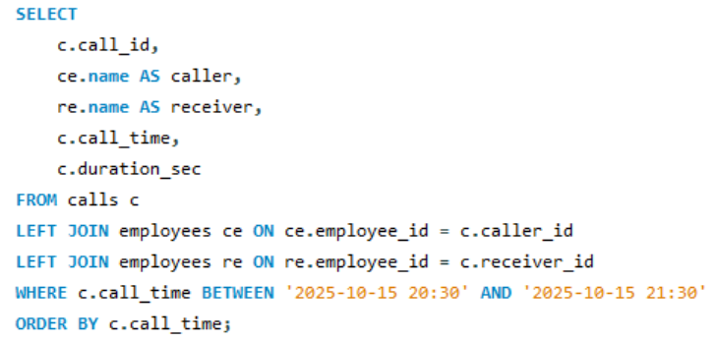
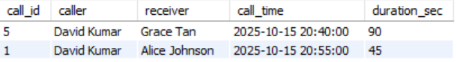
Check Suspicious Phone Calls
🎯 Goal
Find calls made ±30 minutes around the crime.
🧩 Clue Expected
Did the suspect talk to someone just before or after the incident?

Slide 16
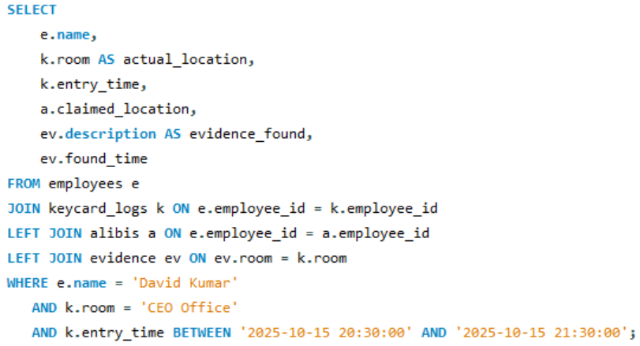
Match Evidence With Movements
🎯 Goal
Check if evidence discovery matches presence of any employee.
🧩 Clue Expected
Who was close to the evidence time and in the crime room?

Slide 17
04
CONCLUSION
The real killer’s mask is going to be revealed very soon…

Slide 18
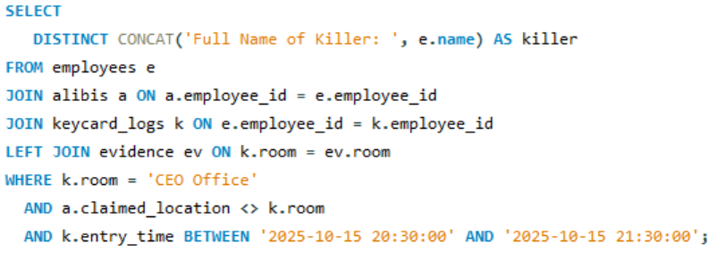
Combine of All Findings
🎯 Goal
Return only the killer’s name in required format.
🧩 Clue Expected
Exactly one employee fits all 3 conditions.

Slide 19
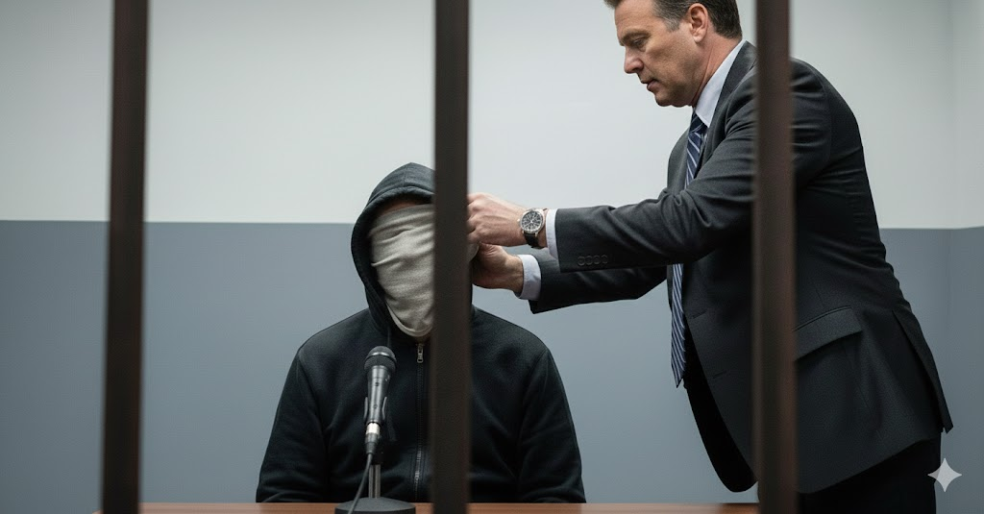
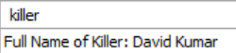
THE FINAL KILLER
DAVID KUMAR

Slide 20

CASE SOLVED: Explanation of Findings
The killer is David Kumar. This conclusion was reached by cross-referencing multiple company databases to establish a pattern of presence and deception.
Presence at the Scene (Keycard Logs): The investigation first filtered the `keycard_logs` for the time of the murder (around 21:00:00). David Kumar was identified as the only person logged into the CEO Office from ‘20:50:00 to 21:00:00’, placing him directly at the crime scene.
Alibi Contradiction (Alibis & Keycard Logs): When checking his statement in the `alibis` table, David Kumar claimed to be in the Server Room. This was a confirmed lie, as his keycard logs contradicted this claim.
Suspicious Communication (Calls): The `calls` table showed David Kumar made a critical call to Alice Johnson at 20:55:00, while he was still logged inside the CEO Office. This indicates communication immediately before the crime was completed.
Physical Evidence (Evidence): Final analysis confirmed physical evidence, including a Fingerprint on desk and a Keycard swipe logs mismatch, were found in the CEO Office, further connecting David Kumar to the crime and an attempted cover-up.
All data streams point consistently and exclusively to David Kumar as the culprit.

Slide 21
🕵️‍♂️ Case Summary
David Kumar was the only employee logged in (20:50:00–21:00:00).List all the key concepts to remember
David Kumar claimed the Server Room, which was proven false by the keycard logs.List all the key concepts to remember
David Kumar called Alice Johnson at 20:55:00 while at the crime scene.
A Fingerprint on desk and a Keycard swipe logs mismatch were found at the crime scene. David Kumar's log entries, false alibi, and call activity all completely contradict his statement.

Slide 22


THANKS!
DO YOU HAVE ANY QUESTIONS?
iarindamdas7@gmail.com
https://www.linkedin.com/in/Arindam-das-analytics

Slide 23
RESOURCES OF THIS TEMPLATE
ICON PACK
Icon pack: Crime investigation Lineal
FOR MORE INFORMATION ABOUT EDITING SLIDES, PLEASE READ OUR FAQS OR VISIT OUR BLOG:
https://slidesgo.com/faqs and
https://slidesgo.com/slidesgo-school

